Slide 1



Resilient and Scalable Architecture for Permissioned Blockchain Fabrics
Suyash Gupta
Exploratory Systems Lab
University of California Davis
Advisor: Mohammad Sadoghi

Slide 2
What is Blockchain?
New
Block
Previous
Hash
Genesis
Previous
Hash
Previous
Hash
Data
Data
Data
Client Transactions
Linked List of Blocks
Hash of Previous Block

Slide 3
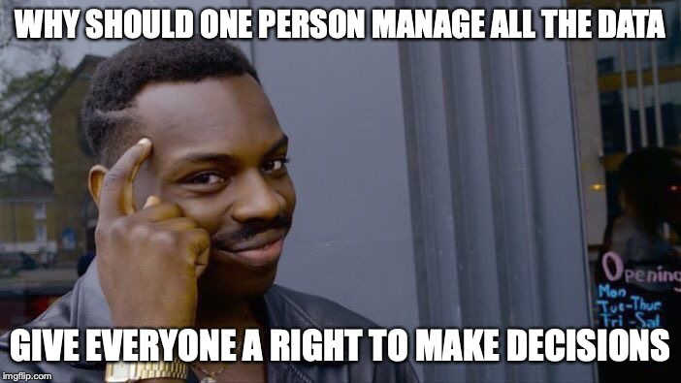



Why Blockchain?
Democracy
Decentralization
Authentication
Security
By User:Pedant, User:Wapcaplet, User:Antonu, User:Vanderlindenma, User:.js. - Composition of File:Barnstar of Diligence Hires.png + File:Voting hand.svg., CC BY-SA 3.0, https://commons.wikimedia.org/w/index.php?curid=45960536

Slide 4




At the core of any Blockchain application is a Byzantine Fault-Tolerant (BFT) consensus protocol.
OK
OK
Order Txn
OK

Slide 5
First practical BFT implementation.
Practical Byzantine Fault Tolerance (PBFT)
Client
T
Primary
Replica 1
Replica 2
Byzantine
Replica
Client
Request
Pre-Prepare
O(n)
Prepare
O(n²)
Commit
O(n²)
Reply
Execute
Consensus among n replicas & at most f byzantine → n >= 3f+1
n = 4 replicas and f <= 1

Slide 6
Requirements of Existing BFT Protocols
Require three phases of communication, of which two necessitate quadratic communication (PBFT).
Expect no failures or dependence on clients (Zyzzyva).
Incur high client latencies due to many phases of communication (PBFT, HotStuff).
Require threshold signatures, which are computationally expensive (HotStuff).
Require more than 3f+1 replicas (Q/U, HQ).
Need trusted components (AHL, Attested Append-only memory).

Slide 7
Speculative Execution
Proof-of-Execution (PoE)
Three-phase Linear protocol
Out-of-Order Message Processing
No dependence on clients or trusted component.

Slide 8
Proof-of-Execution (PoE)
Client
T
Primary
Replica 1
Replica 2
Byzantine
Replica
Client
Request
Pre-Prepare
Prepare
Certify
Reply
Execute
n = 4 replicas and f <= 1

Slide 9
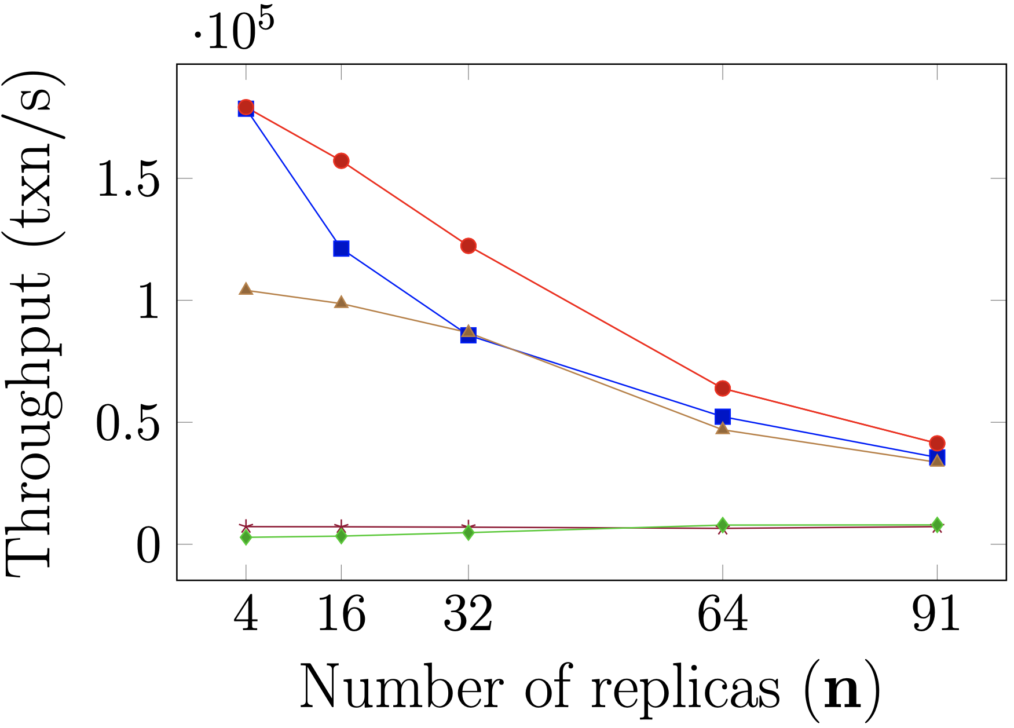
Scalability
24x
72%
Single Failure Experiments

Slide 10
Resilient Concurrency Control (RCC) Paradigm
Democracy → Give all the replicas the power to be the primary.
Parallelism → Run multiple parallel instances of a BFT protocol.
Decentralization → Always there will be a set of ordered client requests.

Slide 11
Resilient Concurrency Control Paradigm
Parallelism
Ordering
Execution
BFT protocol
Run z parallel BFT
instances.
Create a global order
of all the requests.
Execute the requests
in a global order.
Number of
Instances (z)
RCC can employ several BFT protocols: PBFT, Zyzzyva, SBFT and PoE.

Slide 12
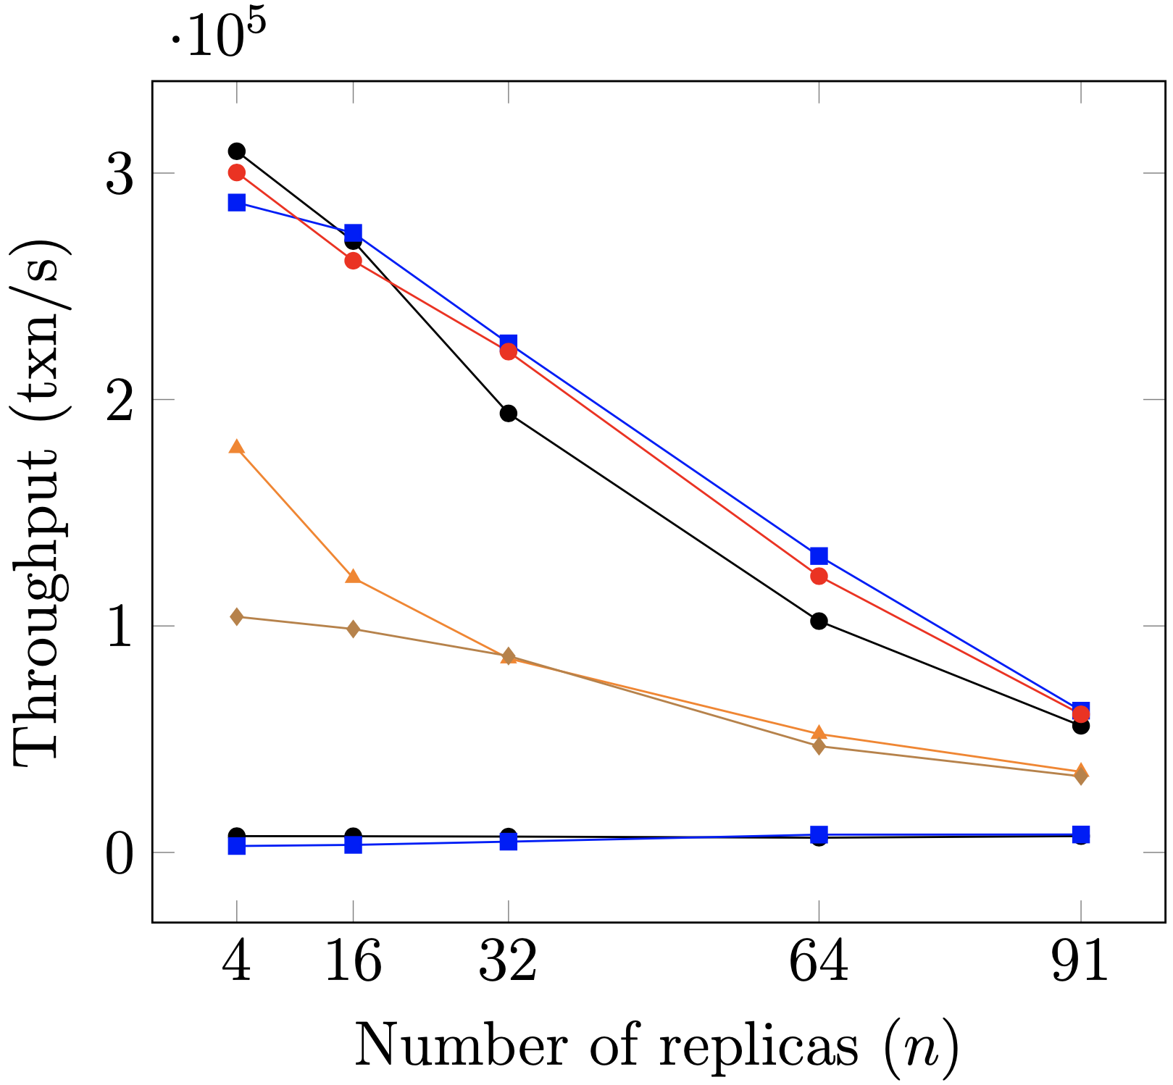
Scalability
26x
Single Failure Experiments

Slide 13
Global Scale Resilient Blockchain Fabric (GeoBFT)*
Existing BFT protocols do not scale to geographically large distances.
Blockchain requires decentralization at global scale → expensive communication!
The underlying BFT consensus protocol should be topology-aware.
*Proceedings of the VLDB Endowment 2020.

Slide 14
Client
T₁
P_{C1}
Local PBFT Consensus on T₁
R_{1,1}
Cluster 1
C₁
R_{1,2}
R_{1,3}
Client
T₂
P_{C2}
Local PBFT Consensus on T₂
Cluster 2
C₂
R_{2,1}
R_{2,2}
R_{2,3}
Local Request
Local Replication
Global
Sharing
Local
Sharing
Reply

Slide 15
ResilientDB: High Throughput Yielding, Scalable Permissioned Blockchain Fabric*
Visit at: https://resilientdb.com/
*Proceedings of the 40th IEEE ICDCS 2020.

Slide 16
Dissecting Existing Permissioned Blockchains
Single-threaded Monolithic Design
Successive Phases of Consensus
Integrated Ordering and Execution
Strict Ordering
Off-Chain Memory Management
Expensive Cryptographic Practices

Slide 17
ResilientDB Architecture
SECURE
LAYER
EXECUTION LAYER
THREADS
SIGNING
TOOLKIT
QUEUES
NET WORK
HASHING
TOOLKIT
BFT CONSENSUS
STORAGE LAYER
METADATA
BLOCKCHAIN

Slide 18

Future Directions and Open Problems
GeoBFT requires each cluster to order and execute all the requests. Can we employ data-partitioning?
Existing sharded blockchain systems have very expensive communication cost for multi-shard transactions. How to achieve optimal communication in such sharded blockchains.
Can we employ machine learning and data-mining techniques to predict and analyze malicious participants and eliminate their effects ahead of time?

Slide 19
Other Research Works
Efficient Commitment in Partitioned (Sharded) Databases.
EasyCommit [EDBT’18] → Two-Phase Non-Blocking Commit Protocol.
GeoScale EasyCommit [Distributed and Parallel Databases (DAPD) 2020]
Efficient Concurrency Control in Partitioned Databases.
QStore [EDBT’20] → Queued approach for distributed concurrency control.

Slide 20
Meet us at VLDB’20
Research Paper, “ResilientDB: Global Scale Resilient Blockchain Fabric”.
1st September 2020 at 9:15am PST
3rd September 2020 at 9:15pm PST
Tutorial, “Building High Throughput Permissioned Blockchain Fabrics: Challenges and Opportunities”
1st September 2020 from 9am – 12am PST
Demo, “Scalable, Resilient and Configurable Permissioned Blockchain Fabric”
2nd September 2020 from 11am - 12pm PST
2nd September 2020 from 11pm - 12am PST

Slide 21
Thank You

